Slide 1
Radiation Protection Training for Users of Sealed Radioactive Sources
May 2022
Tony Butterworth
University Radiation Protection Adviser (RPA)
University Radioactive Waste Adviser (RWA)

Slide 2
Introduction This document is designed to meet the training requirements of users of sealed sources of ionising radiation. Sealed source users do not usually work directly with unsealed ionising radiation, thus greatly reducing the potential for internal exposure.
Radiation Protection Training for Users of Sealed Radioactive Sources
May 2022

Slide 3
Also, because of the nature of most sealed sources, the potential for external radiation exposure is greatly reduced. Sealed source users, like other users of ionising radiation, must receive training which meets legislative requirements and University policy.
Radiation Protection Training for Users of Sealed Radioactive Sources
May 2022

Slide 4
The topics covered in this training will include:
Radiation Protection Training for Users of Sealed Radioactive Sources
May 2022
Introduction to ionising radiation (types, sources, properties)
Effects of exposure to ionising radiation
Monitoring, survey, security and posting requirements

Slide 5
All training (including further local training embracing risk assessment and standard operating procedures and refresher training) must be formally recorded using a suitable record of training form.
Radiation Protection Training for Users of Sealed Radioactive Sources
May 2022

Slide 6
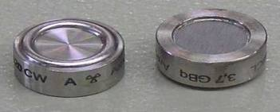
Definition of Sealed Source "Sealed Source" is a term used to describe radioactive sources which have been designed to prevent spread of radioactive material under normal working conditions.
Radiation Protection Training for Users of Sealed Radioactive Sources
May 2022

Slide 7
The definition of a sealed source is given in Regulation 2 (1) of the Ionising Radiations Regulations 2017 (IRR17) ‘A sealed source means a radioactive source whose structure is such as to prevent, under normal conditions of use, any dispersion of radioactive substances into the environment, but it does not include any radioactive substance inside a nuclear reactor or any nuclear fuel element’.
Radiation Protection Training for Users of Sealed Radioactive Sources
May 2022

Slide 8
The view from the Health & Safety Executive (HSE) is the term sealed source should only be applied either to sources where the source of ionising radiation is used directly as a source in work with ionising radiation, or where the indirect properties of the ionising radiation of the source are used. An example of the latter would be a thermoelectric generator, where the radioactive properties of a material generate heat which is used to produce electricity.
Radiation Protection Training for Users of Sealed Radioactive Sources
May 2022

Slide 9
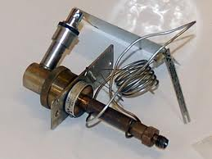
Examples of sealed sources include:
Radiation Protection Training for Users of Sealed Radioactive Sources
May 2022
Nickel-63 electron capture detector (Ni-63 ECD) - the radioactive isotope Ni-63 is electroplated to a metal foil. The foil is installed by the manufacturer in an inaccessible chamber inside the ECD cell.

Slide 10
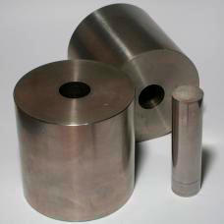
Radiation Protection Training for Users of Sealed Radioactive Sources
May 2022
Cesium-137 (Cs-137) or cobalt-60 (Co-60) gamma sources. These usually contain a small, pea sized source which is sealed in a small welded capsule. The capsule is encased in a shield, usually lead, with a small shuttered opening which controls the gamma beam.

Slide 11
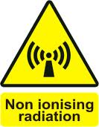
Types of Radiation The various types of radiation can be divided in to two categories:
Radiation Protection Training for Users of Sealed Radioactive Sources
May 2022
Non-ionising: examples of non-ionising radiation include visible light, heat, UV, radio waves
Ionising: examples of ionising radiation include x-rays, gamma rays, and alpha and beta particles.

Slide 12
"Ionisation" is a process whereby a molecule is split into two or more parts called ions. The molecule could be as simple as a water molecule being split into H+ (hydrogen) and OH (hydroxide), or as complex as a long organic molecule such as DNA being split in to two new organic molecules. Ionising radiation is simply any radiation which can impart enough energy to cause ionisation of the target material.
Radiation Protection Training for Users of Sealed Radioactive Sources
May 2022

Slide 13
The resulting ions produced by ionisation are electrically charged. These ions can go on to produce further chemical changes in the surrounding material, thus a single ionisation event could lead to a chain of chemical reactions. Ionising radiation is just one of many processes which can cause ionisation in matter. The human body is constantly repairing itself from natural processes which produce ionised molecules, such as natural metabolic processes, and molecular breakdown from the inherent instability of large organic molecules like DNA.
Radiation Protection Training for Users of Sealed Radioactive Sources
May 2022

Slide 14
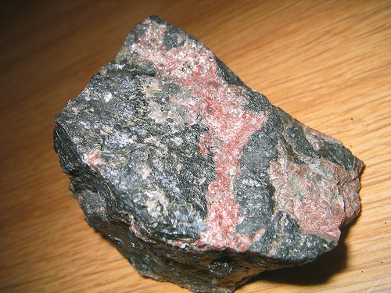
Sources of Ionising Radiation There are many sources of naturally occurring radioactive material, such as uranium and thorium in soil and rock, and carbon-14 in the atmosphere.
Radiation Protection Training for Users of Sealed Radioactive Sources
May 2022

Slide 15
There are also artificially produced radioactive materials, such as nickel-63 in electron capture detectors, Cs-137, Am-241/Be neutron sources, and many more. Regardless of whether the radioactive material is natural or artificial, these materials will continue to emit ionising radiation until all the material is depleted through the radioactive decay process. This can take thousands of years for an isotope such as Ni-63 with a 100-year half-life.
Radiation Protection Training for Users of Sealed Radioactive Sources
May 2022

Slide 16
In contrast to radioactive material, x-ray machines produce ionising radiation only when they are energised. When the machine is not energised, no ionising radiation is being produced, and thus no ionising radiation hazard exists. Unlike x-ray machines, with radioactive material there is always a risk from exposure to ionising radiation.
Radiation Protection Training for Users of Sealed Radioactive Sources
May 2022

Slide 17
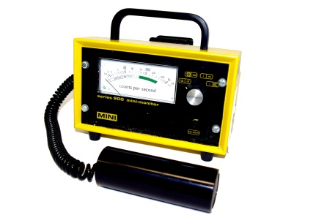
Properties of Radiation There is no sensory response to exposure from ionising radiation. Like radio waves, ionising radiation in normal intensities cannot be seen, felt, tasted or smelled. It can only be detected by radiation detectors, such as Geiger-Mueller counters, film badges and liquid scintillation counters (LSC’s).
Radiation Protection Training for Users of Sealed Radioactive Sources
May 2022

Slide 18
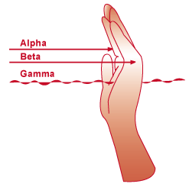
Ionising radiation can penetrate tissue. Its ability to penetrate depends on the type (e.g., gamma, x-ray, beta, neutron, alpha) and energy of radiation.
Radiation Protection Training for Users of Sealed Radioactive Sources
May 2022

Slide 19
Each radioactive isotope has its own type and energy: Gamma radiation, such as that produced by Cs-137 and Co-60, can easily penetrate tissue, glass, wood and even moderate amounts of metal. These radiation sources can pose both an external radiation risk if adequate shielding is not provided, and an internal radiation risk if the source leaks.
Radiation Protection Training for Users of Sealed Radioactive Sources
May 2022

Slide 20
Beta radiation is easily shielded. The level of shielding depends on the energy of the beta radiation. The Ni-63 found in ECD’s is easily shielded by even a sheet of paper because of its very low energy of emission. Thus this isotope has virtually no external radiation risk, though it certainly can be a dangerous source of internal exposure if the source is leaking.
Radiation Protection Training for Users of Sealed Radioactive Sources
May 2022

Slide 21
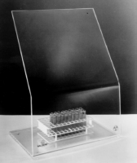
Higher energy beta radiation, such as that produced by Phosphorus-32, requires thicker shielding, such as 10mm of plexiglass. P-32 is an example of a beta emitter which is both an external and internal radiation risk.
Radiation Protection Training for Users of Sealed Radioactive Sources
May 2022

Slide 22
Activity Quantities of radioactive materials are measured in units called "Activity". Units of activity and common conversion factors are listed here: • Becquerels (Bq) • Curies (Ci) • Disintegrations/minute (dpm)
Radiation Protection Training for Users of Sealed Radioactive Sources
May 2022

Slide 23
1 Curie = 2.22x10+12dpm = 3.7x10⁺¹⁰dps 1 Curie = 3.7x10⁺¹⁰ Bq 1 Becquerel = 1 disintegration/second.
Radiation Protection Training for Users of Sealed Radioactive Sources
May 2022

Slide 24
Half-life Radioactive material is constantly undergoing the process of radioactive decay, so the quantity of radioactive material (the activity) is constantly decreasing. Each isotope has its own rate of decay.
Radiation Protection Training for Users of Sealed Radioactive Sources
May 2022

Slide 25
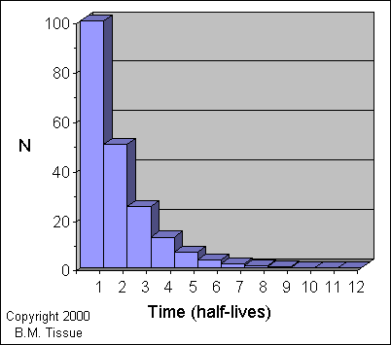
The half-life is the time it takes for one half of the material to be lost by radioactive decay.
Radiation Protection Training for Users of Sealed Radioactive Sources
May 2022

Slide 26
For example, the isotope Ni-63 has a half-life of 100 years. So every 100 years 50% of Ni-63 will have decayed by ionising radiation to the non-radioactive element Copper-63. It will take seven half-lives for a radioisotope to decay to less than 1% of its current activity
Radiation Protection Training for Users of Sealed Radioactive Sources
May 2022

Slide 27
For example, in the case of Ni-63: 100yrs=50% decayed (50% remaining) 200yrs=75% decayed (25% remaining) 300yrs=87.5% decayed (12.5% remaining) 400yrs=93.75% decayed (6.25% remaining) 500yrs=96.875% decayed (3.125% remaining) 600yrs=98.4375% decayed (1.5625% remaining) 700yrs=99.21875% decayed (0.78125% remaining)
Radiation Protection Training for Users of Sealed Radioactive Sources
May 2022

Slide 28
Types of Exposure External exposure occurs when all or part of the body is exposed to a penetrating radiation field from an external source. During exposure this radiation can be absorbed by the body or it can pass completely through. A similar thing occurs during an ordinary chest x-ray.
Radiation Protection Training for Users of Sealed Radioactive Sources
May 2022

Slide 29
Note exposure to a radiation field does not cause an individual to become radioactive; the radiation exposure ceases as soon as the individual leaves the radiation field. All ionising radiation sources produce an ionising radiation field, but some fields are so small they pose no external radiation risk at all. Examples include low energy beta radiation emitters such as H-3, C-14, Ni-63, P-33 and S-35
Radiation Protection Training for Users of Sealed Radioactive Sources
May 2022

Slide 30
Other sources of ionising radiation produce much higher energy ionising radiation fields, and care must be taken to shield the source and to monitor exposure while working around these sources. Examples include: • Am-241 / Be neutron sources • P-32 beta sources • Cs-137 gamma sources • Co-60 gamma sources • X-ray machines (only when the machine is energised)
Radiation Protection Training for Users of Sealed Radioactive Sources
May 2022

Slide 31
The other type of radiation injury involves contamination with radioactive materials. Contamination means radioactive materials in the form of gases, liquids, or solids are released into the environment and contaminate people externally (such as on the skin), internally (such as by ingestion), or both.
Radiation Protection Training for Users of Sealed Radioactive Sources
May 2022

Slide 32
Contamination by radioactive material can lead to incorporation of radioactive material into the body. This can be the result of uptake of radioactive materials by body cells, tissues, and target organs such as bone, liver, thyroid, or kidney. In general, radioactive materials are distributed throughout the body based upon their chemical properties. Incorporation cannot occur unless contamination has occurred.
Radiation Protection Training for Users of Sealed Radioactive Sources
May 2022

Slide 33
All radioisotopes are potentially hazardous if inhaled or ingested. This includes low energy isotopes such as H-3 and Ni-63. Frequent monitoring for contamination is necessary when working with any unsealed isotopes, and periodic leak tests are conducted for sealed sources (1-2 years).
Radiation Protection Training for Users of Sealed Radioactive Sources
May 2022

Slide 34
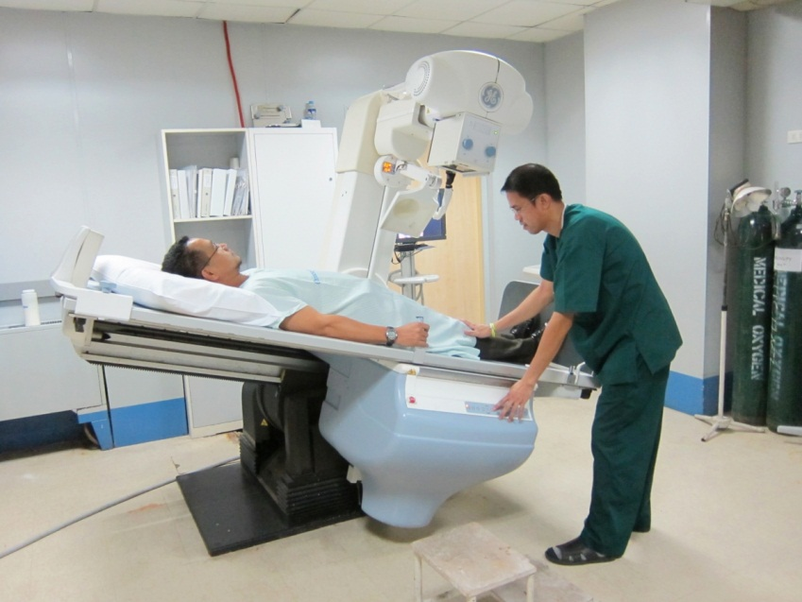
X-ray machines contain no radioactive material, and thus pose no threat of contamination even when energised. When energised, an x-ray machine is a source of external radiation exposure.
Radiation Protection Training for Users of Sealed Radioactive Sources
May 2022

Slide 35
Precautions (External / Internal Exposure) External Exposure The concept of time, distance and shielding is integral in maintaining radiation exposures as low as reasonably practicable (ALARP).
Radiation Protection Training for Users of Sealed Radioactive Sources
May 2022

Slide 36
TIME Assuming "all things are equal", external radiation exposure (dose) is directly related to the duration of exposure. By reducing the time you are in a radiation field, you will correspondingly reduce your dose.
Radiation Protection Training for Users of Sealed Radioactive Sources
May 2022

Slide 37
DISTANCE By maintaining as much distance as possible between you and a source of radiation, you can reduce your dose significantly. The relationship between radiation exposure and distance follows the inverse square law.
Radiation Protection Training for Users of Sealed Radioactive Sources
May 2022

Slide 38
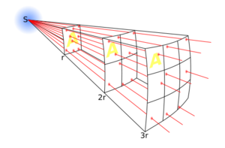
For example, if the dose rate at one metre from a radiation source is 1 mSvhr-1, the dose rate at two metres is reduced to 0.25 mSvhr-1 (1/(2 squared) = 1/4).
Radiation Protection Training for Users of Sealed Radioactive Sources
May 2022

Slide 39
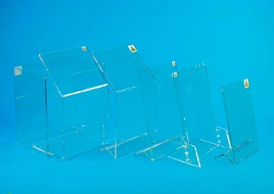
SHIELDING By utilising appropriate shielding, radiation exposure can be reduced significantly. Appropriate shielding depends on the type of radiation. For example, Ni-63 has a weak beta, and requires no shielding, whereas Cs-137 emits gamma radiation and requires heavy shielding, such as lead or concrete blocks.
Radiation Protection Training for Users of Sealed Radioactive Sources
May 2022

Slide 40
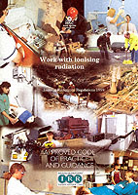
Internal Exposure For sealed sources, internal exposure is controlled by periodic leak tests. The general requirements for leak testing are covered in Regulation 28, IRR 17.
Radiation Protection Training for Users of Sealed Radioactive Sources
May 2022

Slide 41
For most sealed sources, the leak test procedure is: • Swab of exit port, shutter or storage container, which is sent to the RPA / RWA for analysis • A source is considered to be leaking when the leak test shows greater than 200 Bq removable contamination (likely to be greater than x2 background count
Radiation Protection Training for Users of Sealed Radioactive Sources
May 2022

Slide 42
• Leak tests must be performed every year for sources which are outside of manufacturer’s guarantee, otherwise every 2 years up to manufacturer’s guarantee • Records of leak tests must be maintained for at least two years after disposal of any sealed source.
Radiation Protection Training for Users of Sealed Radioactive Sources
May 2022

Slide 43
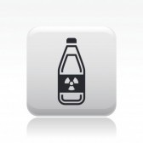
Examples of Radiation Sources Unsealed Sources of Radioactive Material Unsealed radioactive material requires personal protective clothing (e.g., safety specs, lab coat and gloves).
Radiation Protection Training for Users of Sealed Radioactive Sources
May 2022

Slide 44
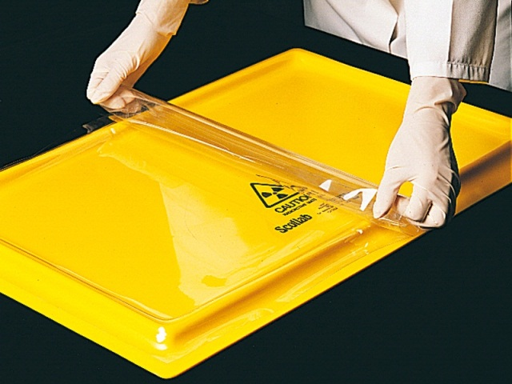
While working with unsealed radioactive material, precautions must be made against the spread of contamination, such as constantly surveying while working with unsealed radioactive material, and use of disposable bench paper around the work area.
Radiation Protection Training for Users of Sealed Radioactive Sources
May 2022

Slide 45
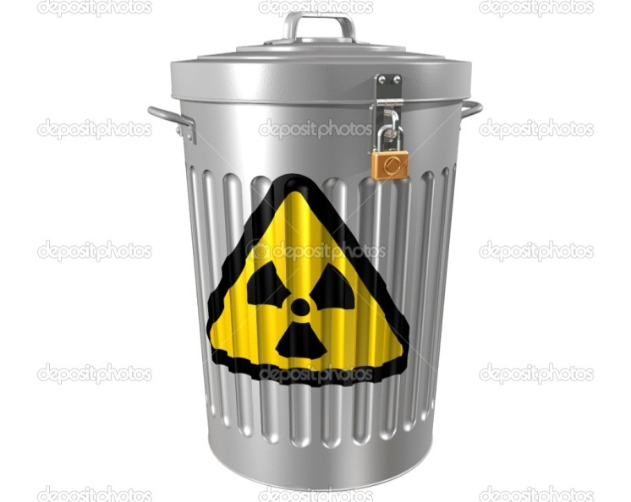
Equipment may become contaminated, such as pipettes, centrifuges, and glassware. There is usually a designated waste bin for radioactive waste. All unsealed radioactive material is a potential internal radiation hazard (e.g., it can be inhaled, ingested or absorbed through the skin, leading to dangerous exposure to internal organs).
Radiation Protection Training for Users of Sealed Radioactive Sources
May 2022

Slide 46
Some isotopes also pose an external radiation hazard (e.g., P-32, Cs-137), and so shielding must be provided while working with this material to protect against exposure to the radiation field. Isotopes such as C-14 and H-3 emit such low energy beta radiation they can be safely handled without concern to external radiation exposure.
Radiation Protection Training for Users of Sealed Radioactive Sources
May 2022

Slide 47
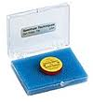
Sealed Sources of Radioactive Material Protective clothing and routine surveys are usually not required when working around sealed sources. There is very little chance material will leak under normal operating conditions, so the risk of contamination is very small, and there is very little risk of internal exposure, such as through ingestion of radioactive material.
Radiation Protection Training for Users of Sealed Radioactive Sources
May 2022

Slide 48
However, any sealed source, regardless of which isotope is used, has the potential to be a hazard if it leaks, so each source should be regularly checked for leakage. External exposure to ionising radiation is possible with gamma and neutron emitting sources. If significant radiation levels are emitted from a source, operators are required to wear personal dosimeters, such as a film or thermo luminescent badge, to monitor exposure to the radiation field.
Radiation Protection Training for Users of Sealed Radioactive Sources
May 2022

Slide 49
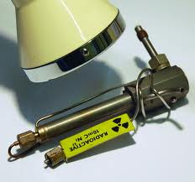
The Ni-63 sources inside an ECD cell produce such low energy beta radiation they have no external radiation risk, and in fact no radiation above natural background can even be detected outside an ECD cell.
Radiation Protection Training for Users of Sealed Radioactive Sources
May 2022

Slide 50
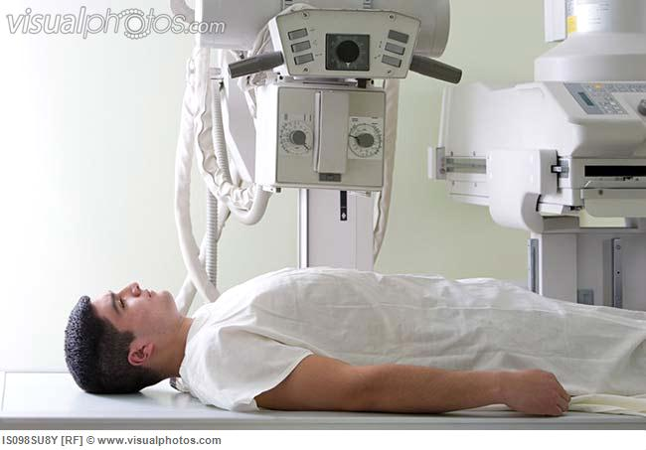
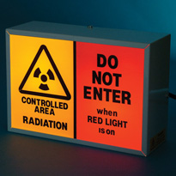
X-Ray Machines X-ray machines only produce ionising radiation when they are energised. Appropriate warning lights indicate when the machine is in operation.
Radiation Protection Training for Users of Sealed Radioactive Sources
May 2022

Slide 51
Naturally Occurring Ionising Radiation Natural background radiation comes from two primary sources: cosmic radiation and terrestrial sources. A much lower level of background radiation comes from human sources e.g., medical, occupational, nuclear discharges, etc.
Radiation Protection Training for Users of Sealed Radioactive Sources
May 2022

Slide 52
Radiation Exposure Exposure to radiation causes a dose. Various organs respond differently to exposure to radiation, so dose is categorised to specify which part of the body received the dose: • Internal vs. External • Penetrating vs. Shallow • Extremity vs. Whole Body • Individual organ dose (e.g., thyroid, eyes, etc.)
Radiation Protection Training for Users of Sealed Radioactive Sources
May 2022

Slide 53
Regardless of how the dose is categorised, radiation dose is reported in units of milliSieverts (mSv). Background radiation is the term which describes non-occupational exposure to radiation sources. The level of background radiation can vary depending on geographic location, occupation and other factors. The average annual exposure from background radiation for a person living in the U.K. is 2.7 mSv.
Radiation Protection Training for Users of Sealed Radioactive Sources
May 2022

Slide 54
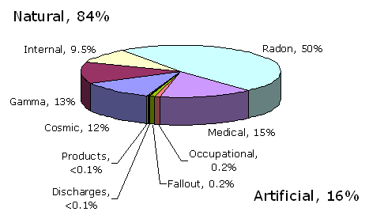
Radiation Protection Training for Users of Sealed Radioactive Sources
May 2022
Contributions to the average UK annual radiation dose (HPA/-RPD-001, Ionising Radiation Exposure of the UK Population: 2005 Review; ISBN 0-85951-558-3)

Slide 55
Occupational radiation exposure is limited by legislation. The annual limits for radiation exposure to occupational radiation workers include: • 20 mSv to whole body • 500 mSv to any organ/tissue • 20 mSv to the eye • Other dose limits apply to specific organs, extremity doses, etc. • These limits are below the levels at which health effects have been seen
Radiation Protection Training for Users of Sealed Radioactive Sources
May 2022

Slide 56
Potential health effects from radiation exposure are determined by the level of dose. Acute Health Effects • Includes immediate radiation sickness, etc. • These effects are observed at levels much greater than the regulatory limits • The threshold for acute effects is about 4 Sv for sickness
Radiation Protection Training for Users of Sealed Radioactive Sources
May 2022

Slide 57
Chronic Health Effects • Health effects occur long after exposure has ceased • Includes cancer, genetic effects, birth defects • These effects are only observed at levels much greater than the regulatory limits, though no lower threshold has been determined for chronic health effects.
Radiation Protection Training for Users of Sealed Radioactive Sources
May 2022

Slide 58
ALARP Because no lower threshold has been determined below which chronic health effects can be ignored, all users of radioactive material must keep their dose As Low As Reasonably Practicable
Radiation Protection Training for Users of Sealed Radioactive Sources
May 2022

Slide 59
The ALARP concept itself grows out of the assumption any radiation exposure carries with it some risk. The ALARP effort is related to balancing the assumed risks of radiation exposure against the benefit of performing the task which may cause the exposure. ALARP also assumes any unnecessary radiation exposures are considered as excessive.
Radiation Protection Training for Users of Sealed Radioactive Sources
May 2022

Slide 60
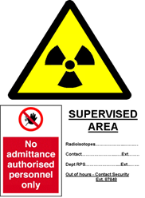
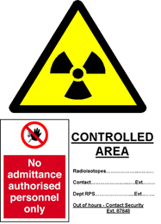
Radiation Warning Signs All designated radiation areas will be clearly marked as containing radioactive material or for use of radiation generating equipment. Appropriate signage is available from the University Radiation Protection Adviser (RPA / RWA), Safety and Health Services.
Radiation Protection Training for Users of Sealed Radioactive Sources
May 2022

Slide 61
Security Access to radioactive material is restricted to authorised individuals only, i.e., those personnel which have completed the associated radiation safety training and who have registered as radiation workers on the Bristol University Radioactive Source Database http://www.bristol.ac.uk/safety/ionising-radiation
Radiation Protection Training for Users of Sealed Radioactive Sources
May 2022

Slide 62
Sealed sources are typically portable and can be small in size, so extra care must be taken to secure them when unattended. Always ensure the door to any designated radiation area is locked when leaving. Sealed sources must be regularly accounted for and a formal recorded check must be carried out on a weekly basis.
Radiation Protection Training for Users of Sealed Radioactive Sources
May 2022

Slide 63
If purchasing a new source, there may be extra security arrangements required by the National Counter Terrorism Security Advisors Team. Therefore, advice should be sought from the University RPA / RWA prior to purchase.
Radiation Protection Training for Users of Sealed Radioactive Sources
May 2022

Slide 64
Transfer and Disposal Contact the University RPA / RWA or Safety & Health Services for transfer and disposal of all sealed sources, or to report lost or stolen sources. For transfer of ownership of a sealed source within the University, form RP08 must be used (available from the download documents section of the University Radioactive Source Database).
Radiation Protection Training for Users of Sealed Radioactive Sources
May 2022

Slide 65
Dosimetry Radiation dosimeters measure external radiation exposure and consist of a body badge and/or finger rings. Issue is required for those radiation workers designated Class 1 or Class 2
Radiation Protection Training for Users of Sealed Radioactive Sources
May 2022

Slide 66
Refer to the ‘Working with Ionising Radiation’ policy and guidance document, section 6.2.1, for University arrangements https://www.bris.ac.uk/safety/media/uobonly/po/ionising-rad-po.pdf
Radiation Protection Training for Users of Sealed Radioactive Sources
May 2022

Slide 67
External dosimeters are not required for medium and low energy beta emitting isotopes, such as for Ni-63, H-3, C-14, P-33 and S-35. Dosimeters must only be used by the person issued the dosimeter (names are listed on the dosimeter label).
Radiation Protection Training for Users of Sealed Radioactive Sources
May 2022

Slide 68
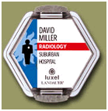
The body badge should be worn where you expect to get the highest dose, e.g., clipped to the lapel.
Radiation Protection Training for Users of Sealed Radioactive Sources
May 2022

Slide 69
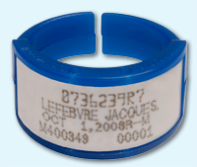
Finger rings are worn under gloves, label facing inward.
Radiation Protection Training for Users of Sealed Radioactive Sources
May 2022

Slide 70
Dosimeters are exchanged every 3 months. In most cases, new badges are issued by the University RPA / RWA to School RPS’s who then distribute them to staff and exchange the old badges for the new ones. Accurate readings of radiation exposure requires timely return of the dosimeters, so they must be readily available to the School RPS when requested.
Radiation Protection Training for Users of Sealed Radioactive Sources
May 2022

Slide 71
University dose investigation levels are set at quarterly readings of – > 5 mSv for a ring badge > 0.2 mSv for a body badge
Radiation Protection Training for Users of Sealed Radioactive Sources
May 2022

Slide 72
Environment Agency Permits The Environment Agency issues permits for the keeping and use of sealed sources, which detail the isotopes and associated activities allowed on University premises.
Radiation Protection Training for Users of Sealed Radioactive Sources
May 2022

Slide 73
A breach of any permit condition could lead to an unlimited fine and /or up to 5 years imprisonment imposed by the Regulator as breaches are usually heard in the Crown Court. It is therefore imperative users of sealed sources read, understand and ensure compliance with all permit conditions.
Radiation Protection Training for Users of Sealed Radioactive Sources
May 2022

Slide 74
Before purchase of any new sealed source, please contact the University RPA / RWA, as a variation to the existing permit may need to be applied for, before the purchase can proceed. The cost to vary the Permit will fall to the School.
Radiation Protection Training for Users of Sealed Radioactive Sources
May 2022

Slide 75
Please note there is no sealed source permit issued for the Langford site. Therefore, only sealed sources which comply with the EPR 2016 sealed source exemptions may be allowed on the Langford site. Contact the School RPS or University RPA / RWA if you require further advice on permit conditions.
Radiation Protection Training for Users of Sealed Radioactive Sources
May 2022

Slide 76
Use of Sealed Sources 1. Always use the minimum activity sealed source required for the experiment. 2. Sources emitting penetrating radiations should never be manipulated directly by hand. 3. To contain penetrating radiations, use appropriate shielding to keep dose rates below 2.5µSvh^{-l} whenever reasonably practicable.
Radiation Protection Training for Users of Sealed Radioactive Sources
May 2022

Slide 77
4. Always wear your personal dosimeter and/ or finger dosimeter if these have been issued to you. 5. Any source not permanently mounted should be kept in properly labelled containers and in an approved locked and labelled store when not in use.
Radiation Protection Training for Users of Sealed Radioactive Sources
May 2022

Slide 78
6. All sources should be engraved or otherwise permanently marked with a unique identification code. If permanently mounted in a source holder, this should bear the identification mark along with details of the isotope, activity and a radiation trefoil, if this is reasonably practicable. 7. If a source is permanently mounted in a piece of equipment, it should not be readily removable, and the equipment should have a suitable warning label.
Radiation Protection Training for Users of Sealed Radioactive Sources
May 2022

Slide 79
8. Do a full monitoring survey of the laboratory when directed to by your School RPS. The results of these surveys should be recorded for future reference. 9. Keep accurate records of all purchases and current stock. It is an offence under the Environmental Permitting Regulations 2016 not to have these up to date.
Radiation Protection Training for Users of Sealed Radioactive Sources
May 2022

Slide 80
10. Locations of sources should be checked on a weekly basis, and these checks recorded. A procedure should be in place to ensure weekly checks are performed over holiday periods (e.g., Christmas, Easter, etc.)
Radiation Protection Training for Users of Sealed Radioactive Sources
May 2022

Slide 81
11. In the event of any accident or incident involving radioactive materials inform your School RPS or the University RPA / RWA immediately, or if these persons are not available contact Safety & Health Services. A central online University accident / incident report form is also required to be completed by the person(s) involved in the accident / incident. -------------------------------------------------------------------------
Radiation Protection Training for Users of Sealed Radioactive Sources
May 2022

